Slide 1
“Arihant- BI Analyst Assignment” GitHub Link for Dashboard:- https://github.com/hemantg111/Arihant_assignment.git
By
Hemant Gupta LinkedIn- https://www.linkedin.com/in/hemant-gupta-4914baa6

Slide 2
Dashboard Overview
This Power BI dashboard provides a comprehensive analysis of Arahant's operational and sales metrics, focusing on key performance indicators such as teacher support, sample distribution, state-wise performance, executive contributions, and institute types.
The data offers valuable insights into how resources are distributed and utilized, the effectiveness of teacher engagement, and the potential areas for market expansion.
Key visuals included in the dashboard:
KPI Cards: Display the total number of institutes, students, and samples distributed to highlight Arihant's outreach and scale.
Donut Charts:
Show the distribution of teacher ratings (Good, Average, Below Average, Unknown).
Visualize the sample distribution methods (Courier, Executive by Hand, Unknown).
Table Visuals:
Analyze teacher support levels with percentage breakdowns for options like full, partial, or no support.
Highlight the final disposition outcomes (Interested, No Response, Not Interested, etc.).
Bar Charts:
Display the samples distributed by top-performing executives.
Highlight the top 5 states by the number of samples distributed in 2024.
Map Visualization: Pinpoints the geographic distribution of institutes by location, providing insights into regional engagement.
Slicers: Enable filtering by parameters such as state, institute type, and whether the institute helped in sales during the 2023–24 year.

Slide 3
Steps Taken to Analyze the Recipe Data
Understanding the Problem:
The task involves analyzing the data based on various parameters to retrieve actionable insights from the dataset.
Data Collection:
Collected raw data in the form of an Excel file.
Export the data into Power BI Desktop using the ‘Get Data' option.
Data Cleaning:
The raw data contained issues such as null values, unnecessary data, error value, and blank data fields.
Performed data cleaning by using Power Query Editor.
Loaded the cleaned data into Power BI Desktop to create visuals based on the specified parameters.
Data Analysis:
Created visuals, including Bar Chart, Donut Chart, Table, Slicers, to analyze the data.
Identified trends and extracted insights from the visuals data.
Interpreting Results:
Derived insights from the visuals.
Compiled a final report detailing the data analysis findings.

Slide 4
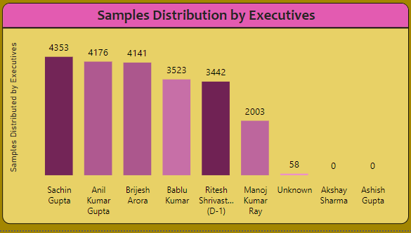
Samples Distribution by Executives
Analysis: Top-performing executives include Sachin Gupta and Anil Kumar Gupta, distributing over 4,000 samples each. Some executives, such as Akshay Sharma and Ashish Gupta, have negligible or zero contributions, suggesting inefficiencies.
Recommendations: Reassign tasks for underperforming executives (e.g., Akshay Sharma, Ashish Gupta) or provide additional training to improve their output. Recognize and reward top performers (e.g., Sachin Gupta, Anil Kumar Gupta) to maintain motivation.

Slide 5
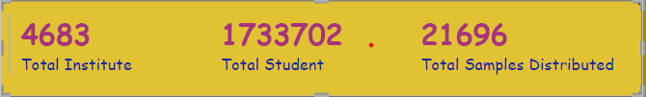
Multi Row Card- Visuals
Multi-Row Card Summary:
Total Institutes Contacted: 4,683
Total Students Reached: 1,733,702
Total Samples Distributed: 21,696
Insights: A total of 4,683 unique institutes were contacted, and 21,696 samples were distributed by the company to enhance sales and gather valuable feedback.

Slide 6
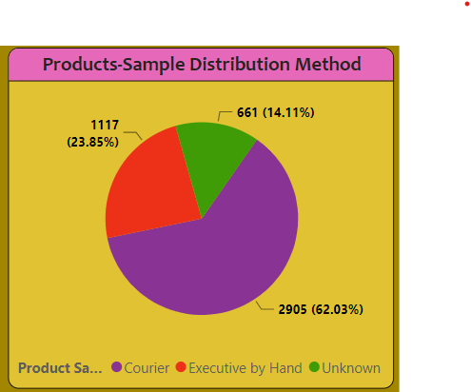
Donut Chart
Distribution:
Courier: 2,905 instances (62.03%)
Executive by Hand: 1,117 instances (23.85%)
Unknown: 661 instances (14.11%)
Insights:
A majority of the sample distribution was done via Courier, which is over 62% of total deliveries.
Distribution via Executive by Hand is significantly lower than distribution via courier.
Recommendation:
Try to Increase hand deliveries by executives, as this helps build personal relationships, which can be beneficial for boosting sales.

Slide 7
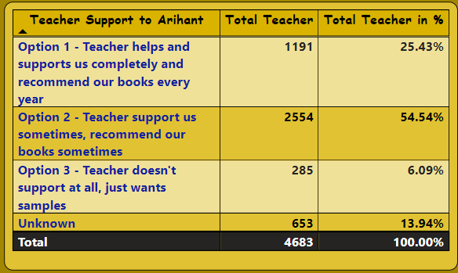
Table Visuals
Teacher Support Distribution:
Over 54% of teachers support Arihant books "sometimes" (Option 2), while only 25% fully support and recommend them (Option 1). Around 6% of teachers does not support, which indicates a lack of engagement or data collection.
Recommendation:
Target teachers in Option 2 with strategic engagement to convert "sometimes" to "complete" support to increase the sales.
Focus on understanding and addressing the “Option-3 Teacher doesn’t support" category to improve teacher alignment.

Slide 8
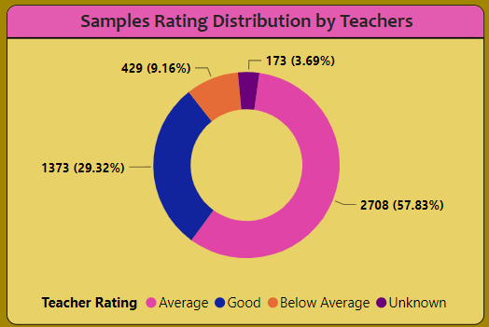
Sample Rating Distribution by Teachers
Analysis-
The majority of samples (57.83%) are rated as “Average”.
29.32% of samples is rated as “Good" and 9.16% of samples is rated “Below Average”.
Recommendation-
Analyze feedback for "Average" and "Below Average" ratings to identify reasons in product perception or quality.
Provide training for executives on presenting the product more effectively.

Slide 9
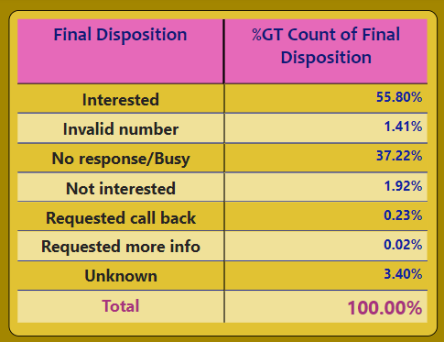
Final Disposition Analysis
Analysis: While 56% of institutes showed interested, and a significant number (37.2%) either didn't respond or were busy. Recommendations: Address issues with invalid numbers and No responses/Busy to ensure effective communication and tracking.

Slide 10
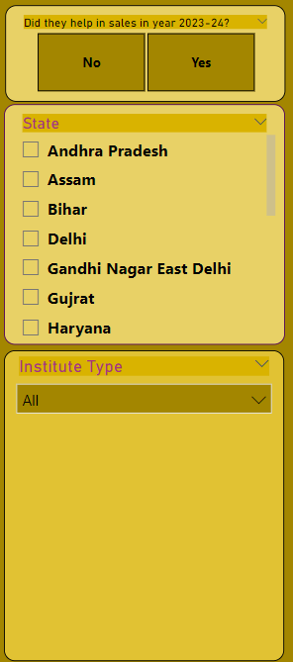
Slicers / Filters
Slicers for Dynamic Filtering and Analysis-
Slicers enable filtering the data by parameters such as State, Institute Type, and whether the institute contributed to sales during the 2023–24 year.
With the use of slicers, we can analyze data dynamically, focusing on specific states or institute types, allowing for more detailed and insightful analysis. This enhances the interactivity of the dashboard and helps in uncovering actionable insights based on selected criteria.

Slide 11
Thank You

